Slide 1
Occluded Facial Expression Detection
Predicting Facial Expressions In Real Time
Final Evaluation
Group Members:
Abdul Mannan K-163620
Murtaza Multanwala K-163618
Muhammad Shahryar K-163750
Supervisor: Ms Javeria Farooq
Co-Supervisor: Ms Syeda Rubab Jaffar

Slide 2
Introduction
Occluded facial expressions detection
Studied existing approaches
Found out the gap
Presented solution to fill the gap

Slide 3


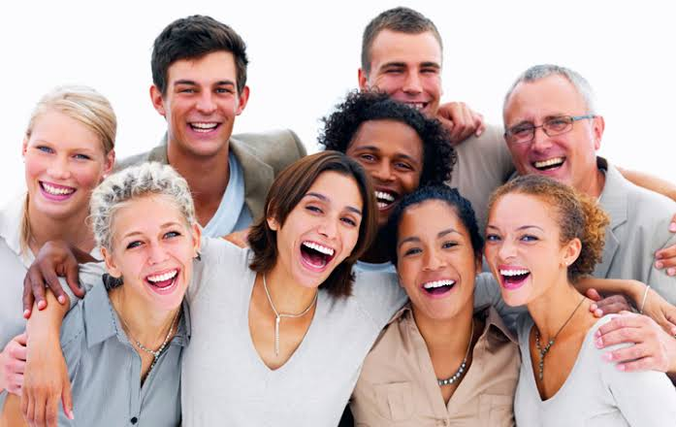
Occlusions

Slide 4
Existing work
Name | Approach | Problem
Octavio [1] | Trained neural network from scratch | Real time, frontal face, not on occlusion
Farhad [2] | Uses 3d face reconstruction technique | Real time, high computational power, single face
Duncan [3] | Transfer learning on VGG S model | Real time, frontal face, not on occlusion
Schwan [4] | Transfer learning on VGG Face model | Real time, single frontal face, not on occlusion
Enrique [5] | Transfer learning approach | Real time, single frontal face

Slide 5
Problem Definition
Although numerous facial expression identification methods have been proposed and built, majority of them are built in controlled surroundings. Mostly, the research is either on frontal faces or either without occlusion. Despite numerous researches [1,4] on different datasets, recognition of facial expression is still challenging because of partially occluded faces.

Slide 6
Objective
1. To investigate a technique of facial expression detection in real time environment.
2. To develop and validate the proposed facial recognition approach on occluded and non occluded students in class rooms.

Slide 7
Problem Scope
This project focuses on building a prototype for generation of automatic feedback on the basis of facial expressions. It can be deployed where the feedback is prioritized such as classrooms, cafes or meeting rooms.

Slide 8
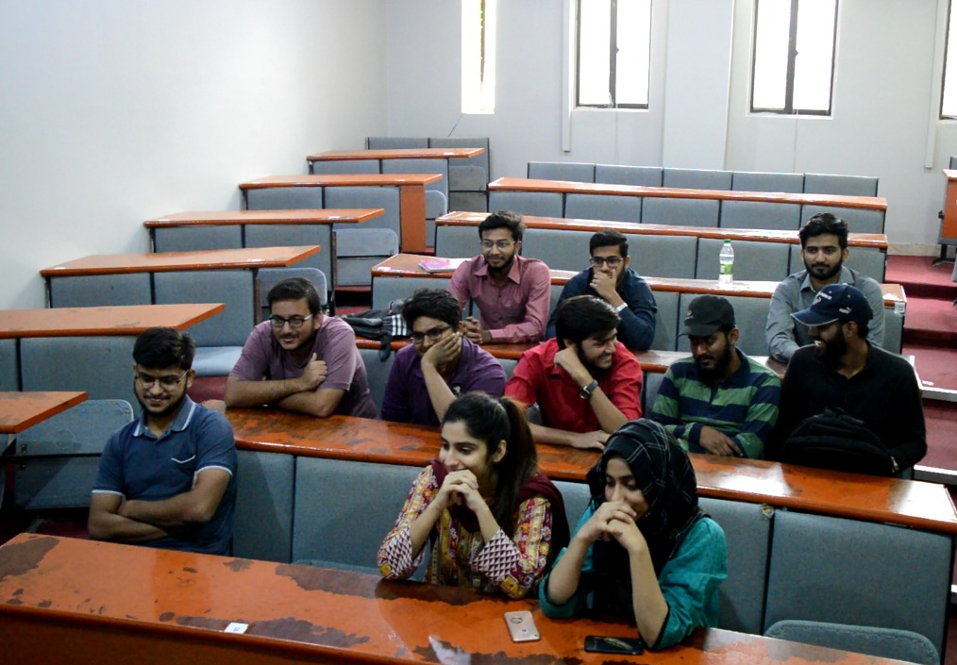
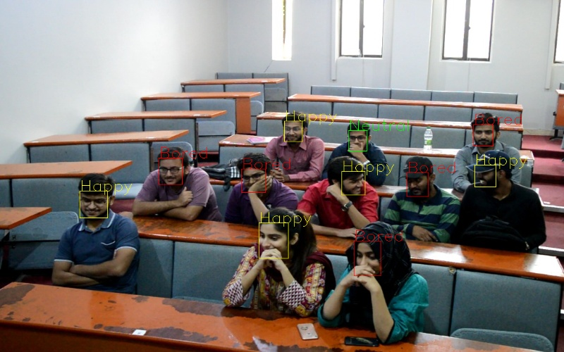
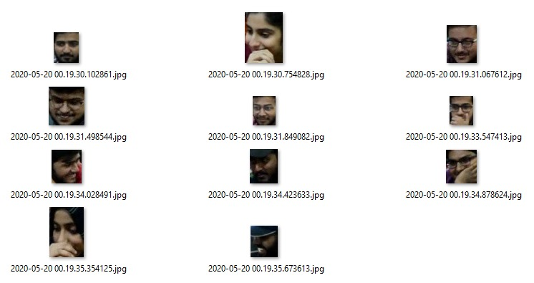
Methodology
1) Camera Feed
3) Final Output
Face Detection
Expression Classification Model
2) Detected Faces
Preprocessing

Slide 9
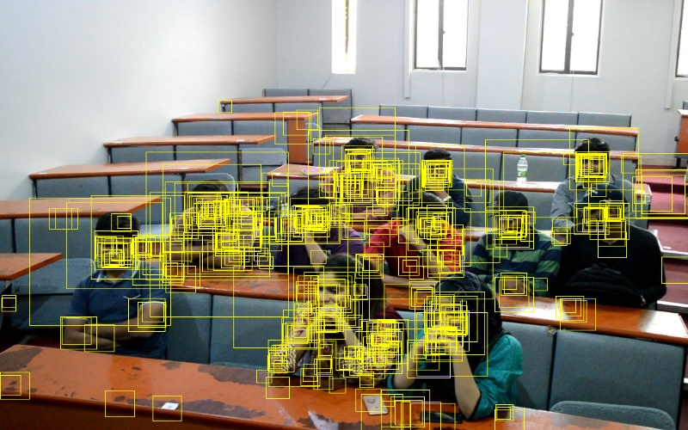
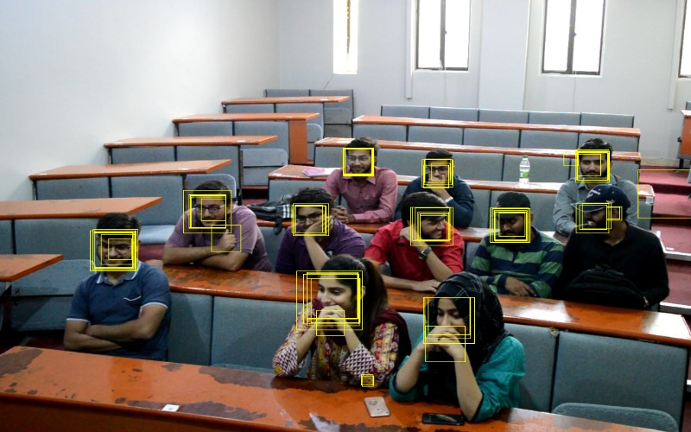
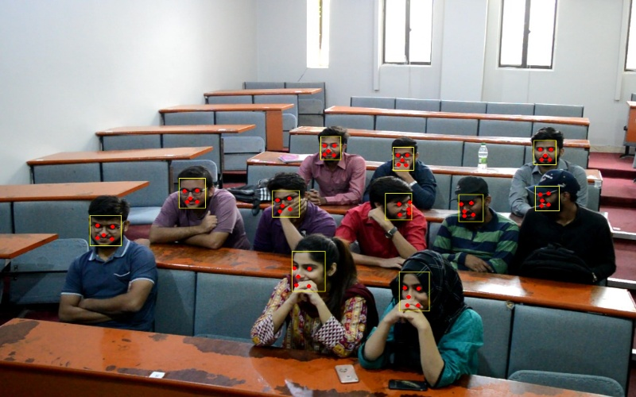
Methodology(Face detection)
Stage 1:
Pass in image
Feed images into P-Net
Gather P-Net output
Delete bounding boxes with low confidence
Reshape bounding boxes to square
Stage 2:
Pad out-of-bound boxes
Feed images into R-Net
Gather R-Net output
Delete bounding boxes with low confidence
Non-Maximum Suppression for all boxes
Reshape bounding boxes to square
Stage 3:
Pad out-of-bound boxes
Feed images into O-Net
Gather O-Net output
Delete bounding boxes with low confidence
Non-Maximum Suppression for all boxes
Delivering Results:
Package all coordinates and confidence levels into a dictionary
Return the dictionary

Slide 10
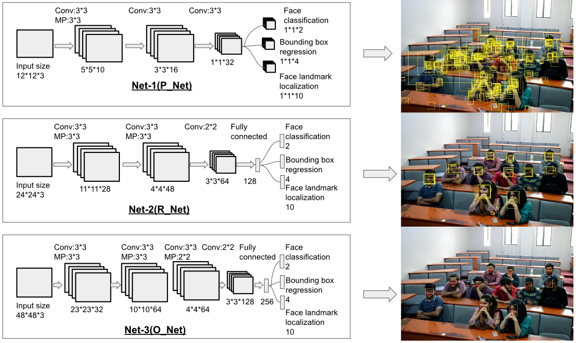
Architecture face detector

Slide 11
Methodology (Facial Expression Recognition Models)
Approach A
Train all the weights of the model from start.
Approach B
Transfer learning (finetune pretrained weights).

Slide 12
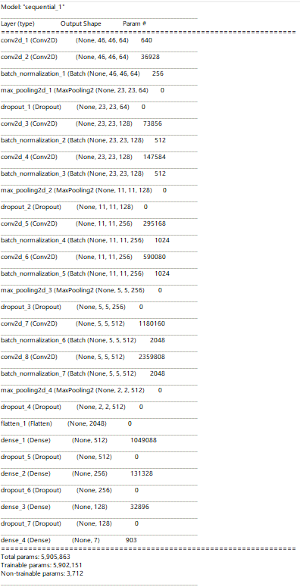
Approach A Architecture

Slide 13
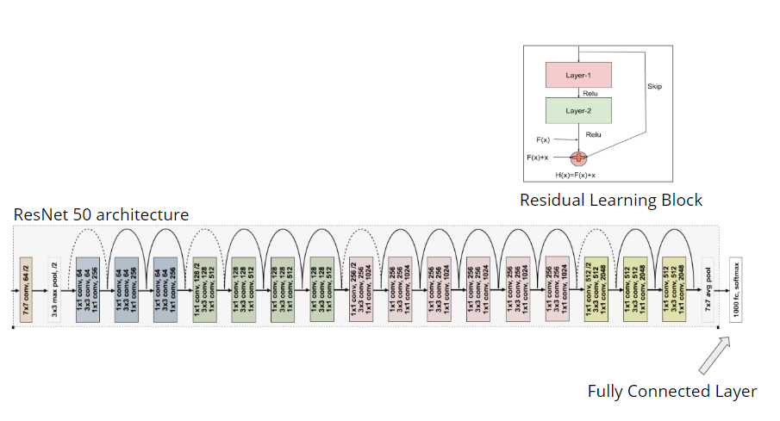
Approach B Architecture

Slide 14
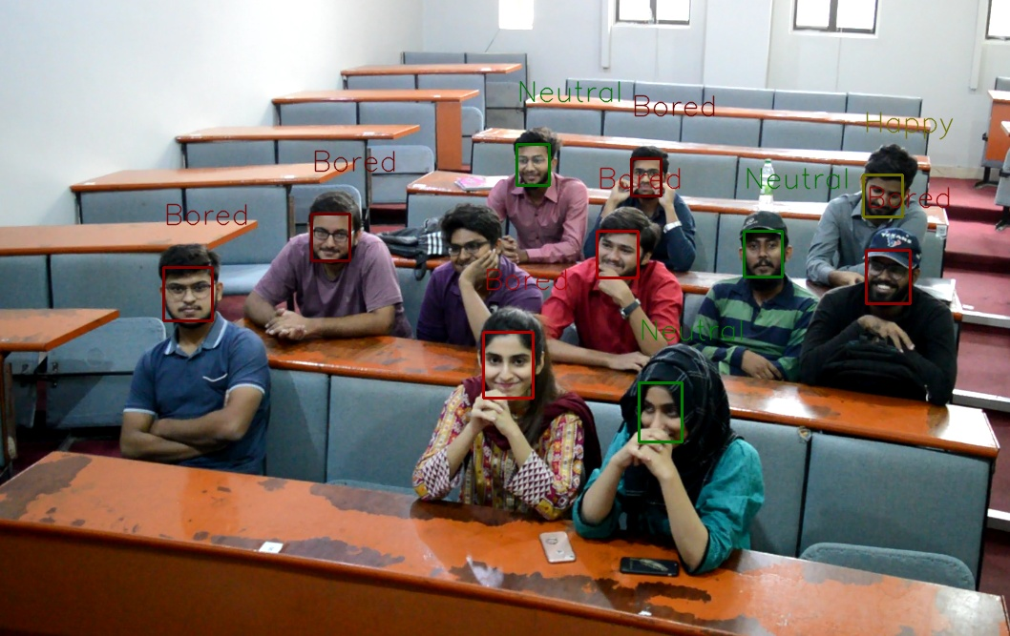
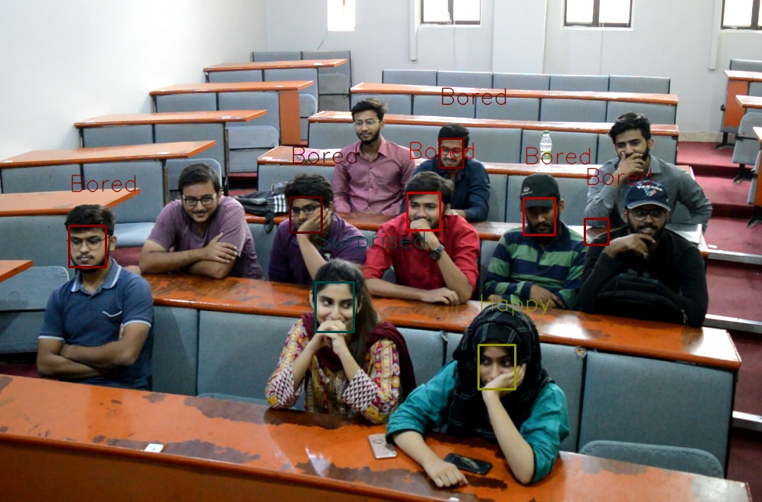
Approach A Results

Slide 15
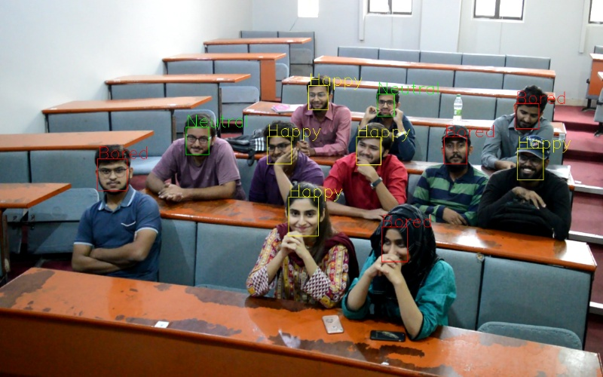
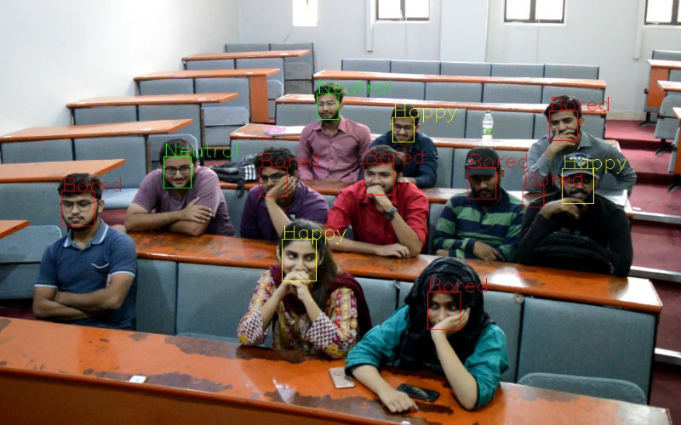
Approach B Results

Slide 16
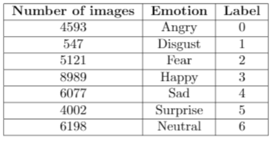
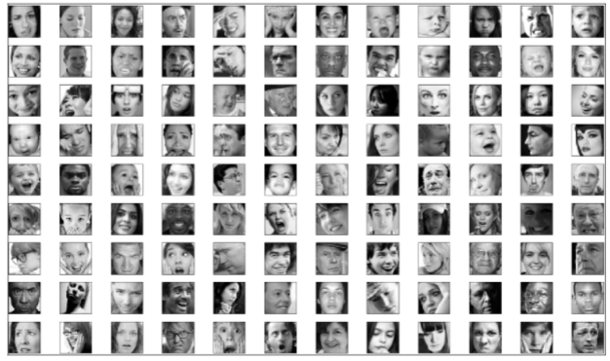
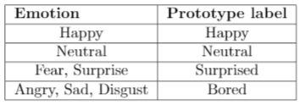
Dataset (FER2013)
Dataset Distribution
FER2013 sample images
Prototype labels
Total: 35,887 (48x48) gray scaled images

Slide 17
Sample Results

Slide 18
FYP-1

Slide 19

Deliverables Achieved
FYP-1
Prototype
Multiple faces detection in real time
Predict facial expressions in real time
Dataset creation
Feedback generation(Jury recommendation)

Slide 20
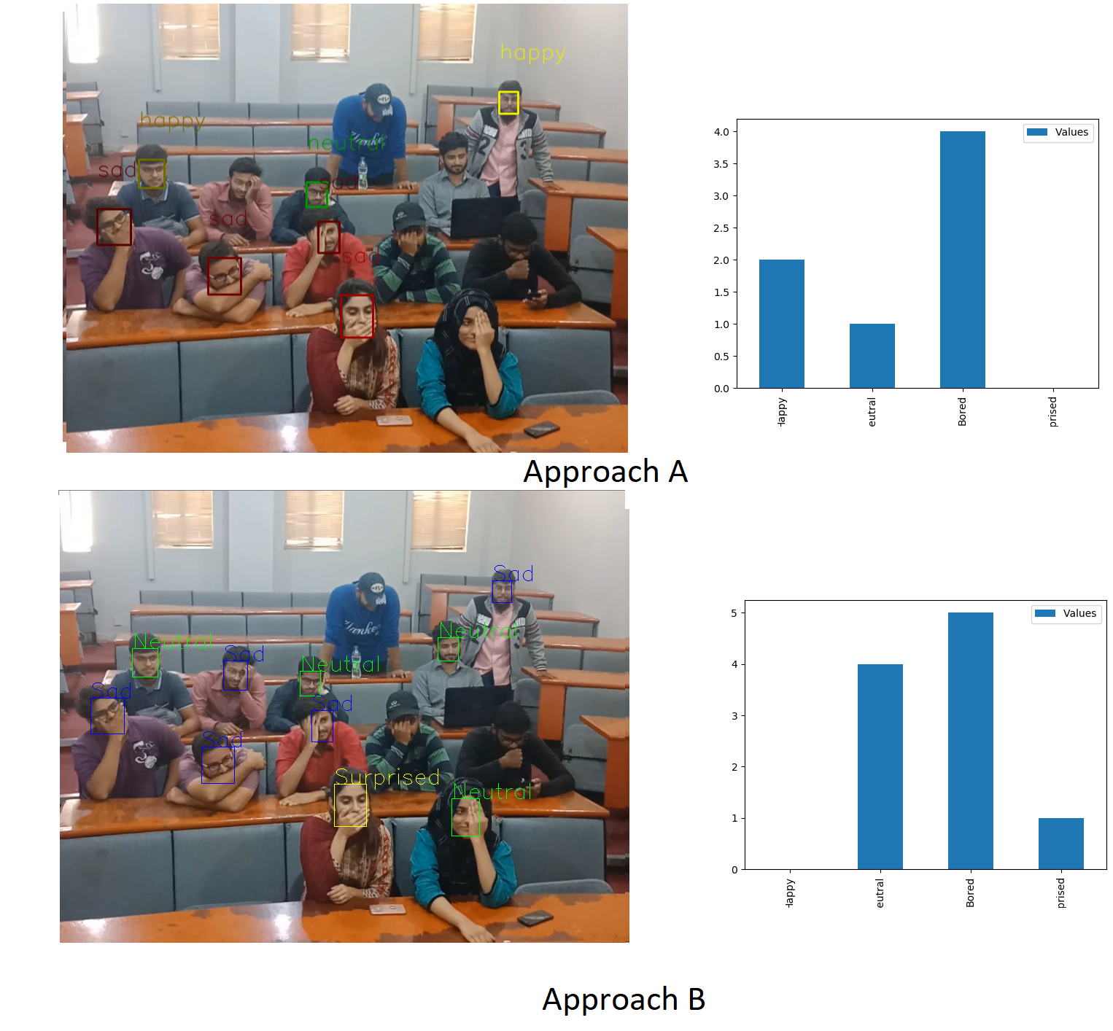

Slide 21
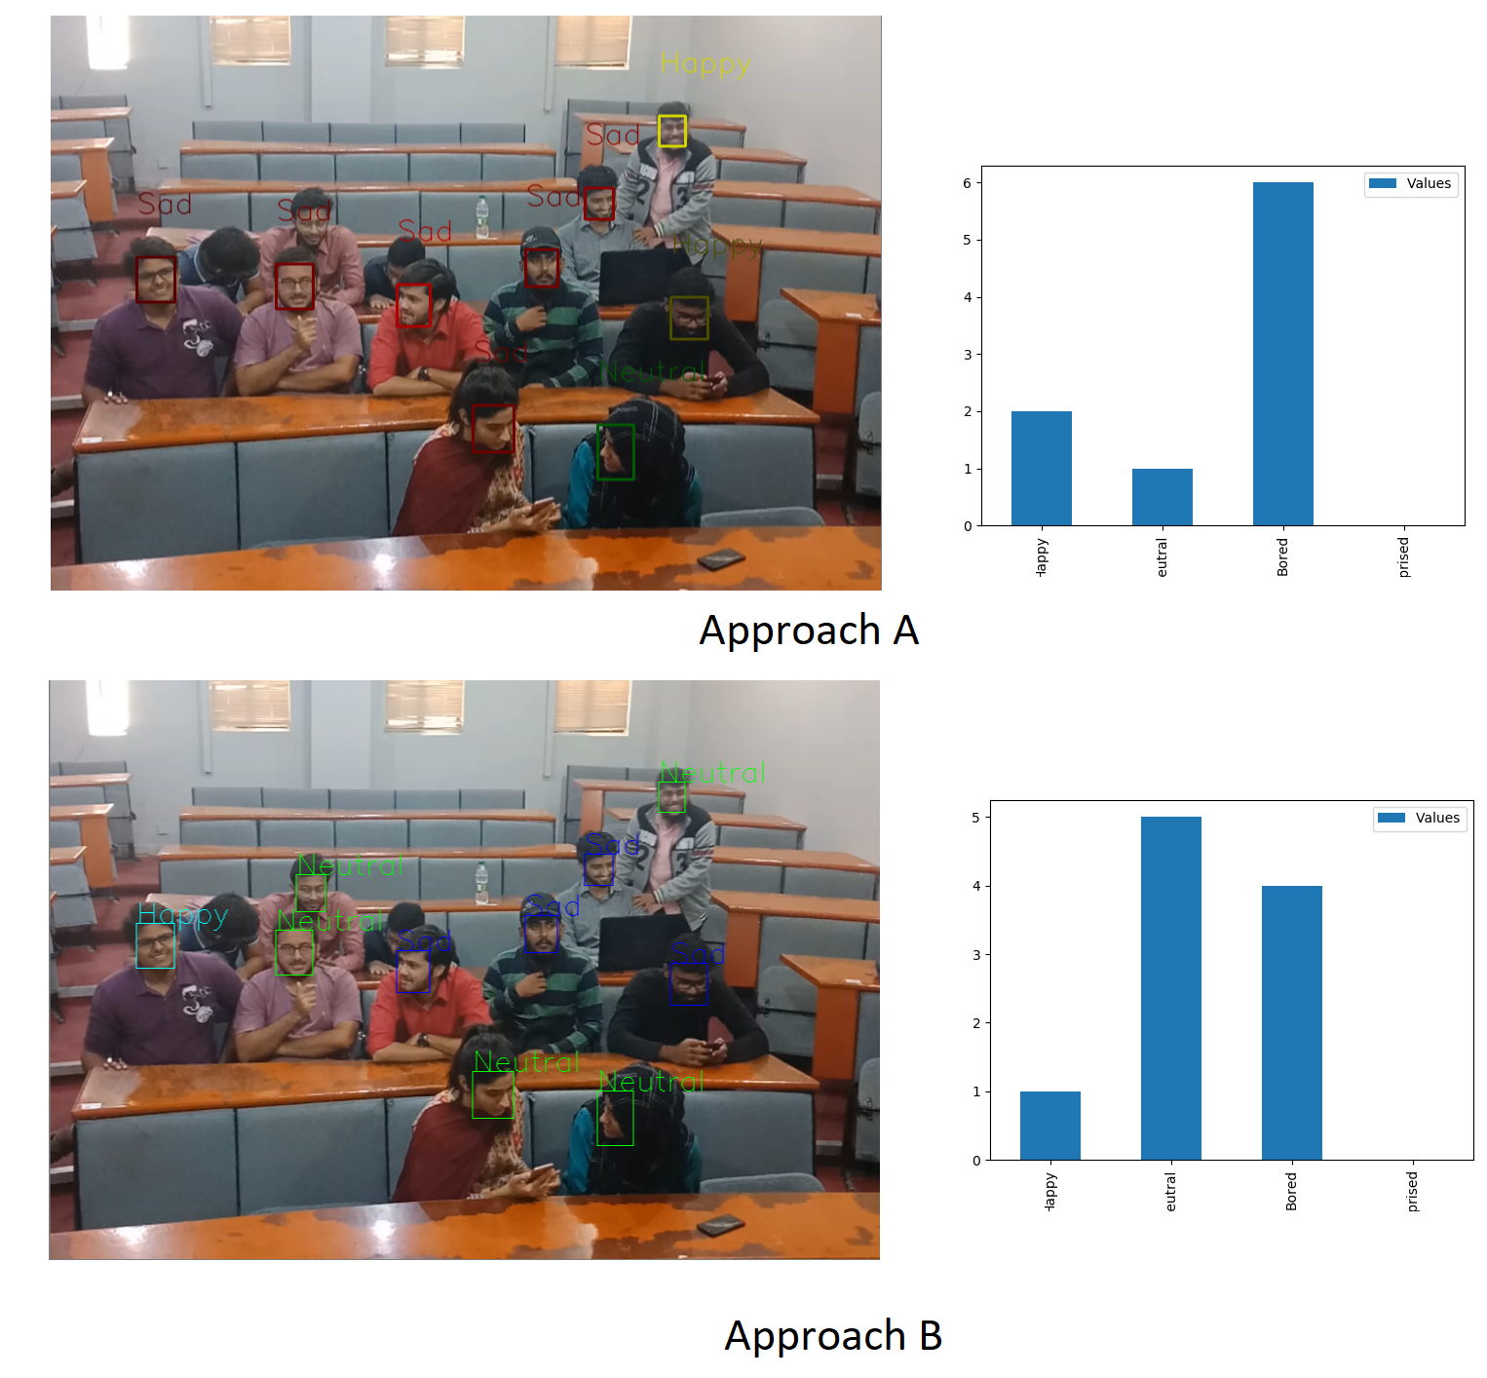

Slide 22
FYP-2(Improvements)

Slide 23
Deliverables Achieved
FYP-2
Improve accuracy of FYP-1
Dataset merge(Jury recommendation)
Creation of Expression Classification Model on merged dataset(Jury recommendation)
Identify facial features(Jury recommendation)
Define Expressions/Emotions (Jury recommendation)
Comparison between Approach A and B(Jury recommendation)
Plotting of segmented images of interest region(Jury recommendation)

Slide 24
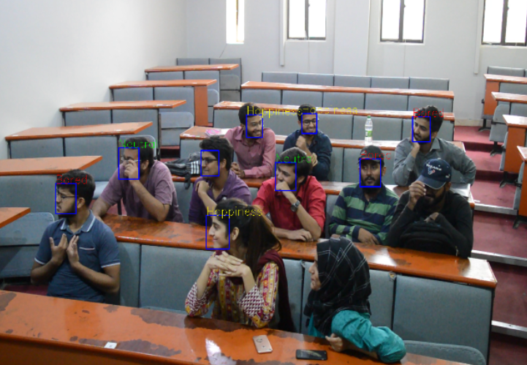

Slide 25
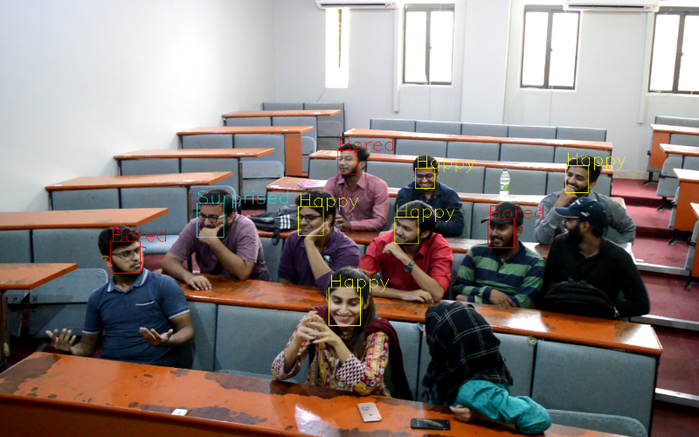

Slide 26
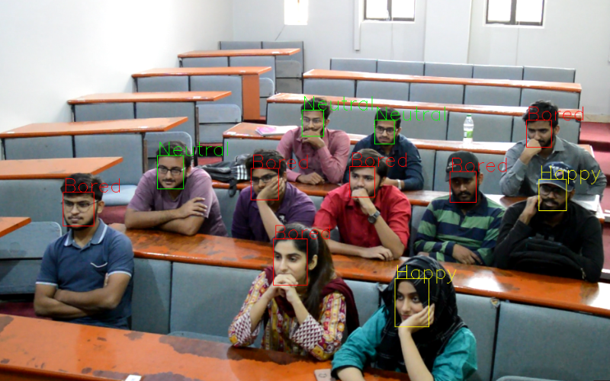

Slide 27
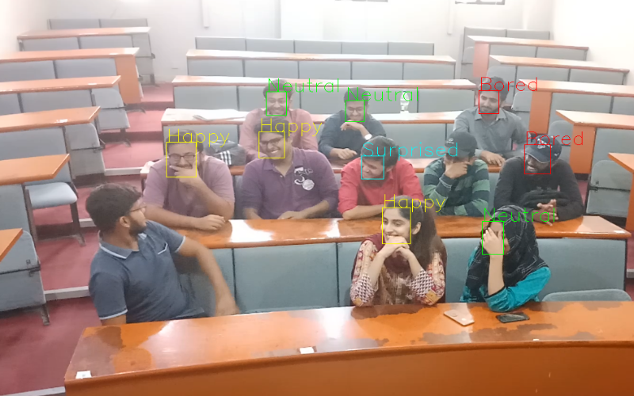

Slide 28
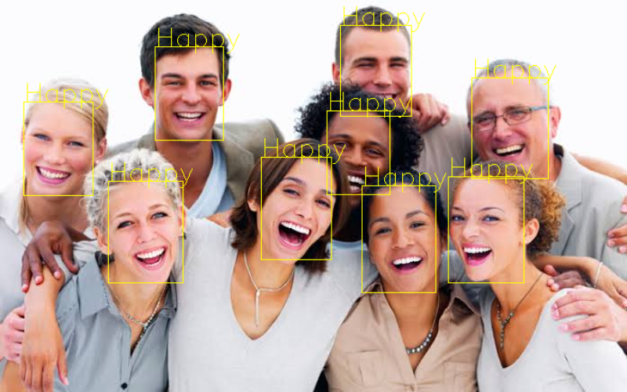
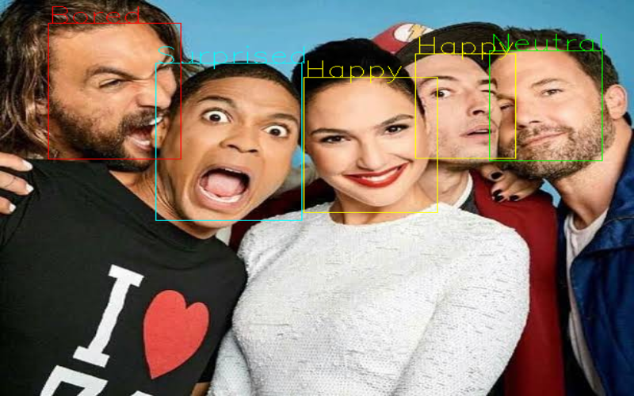
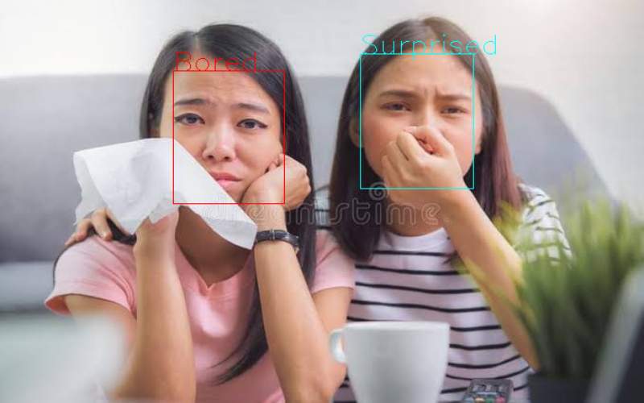
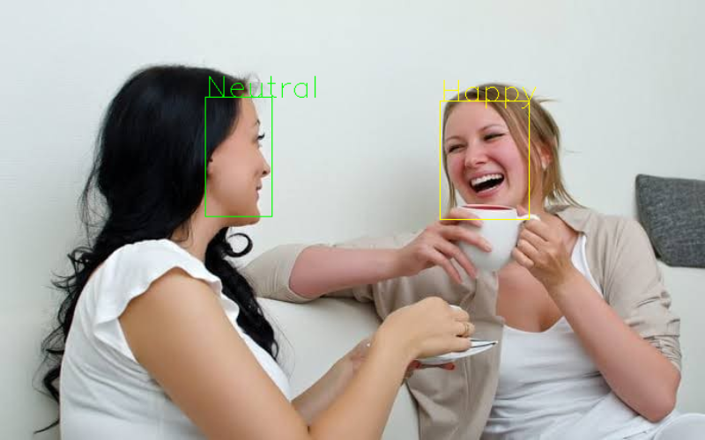

Slide 29
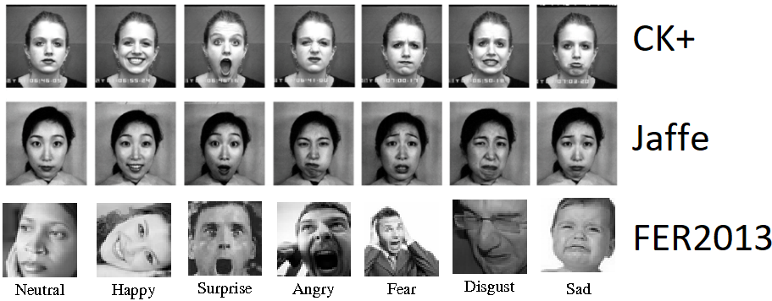
Merged Dataset
CK+ 5,876 images | FER2013 35,887 images | JaFFE 213 images

Slide 30
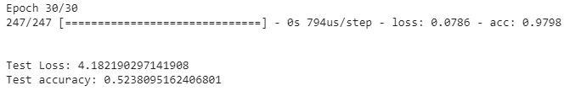
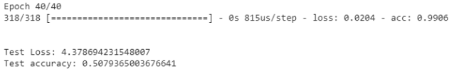
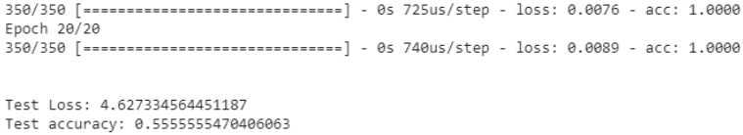
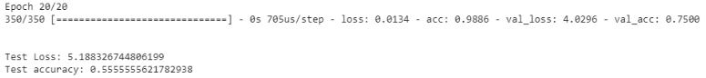
Model Accuracy
Validation split of 0.3 and epoch = 30
Total Images = 417(CK+, FER2013, JAFFE)
Training Images = 354 ⇒ Validation set (X% from training data)
Testing Images = 63 (0.15% of training data)
Validation split of 0.1 and epoch = 40
Validation split of 0.01 and epoch = 20
Validation split of 0.01 and epoch = 20

Slide 31
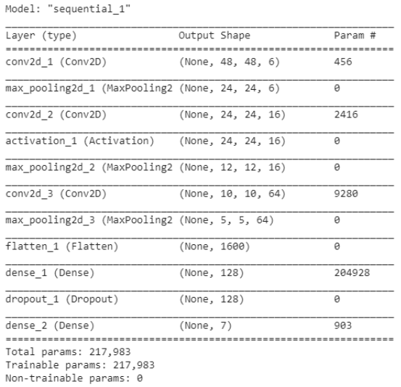
Model Summary

Slide 32
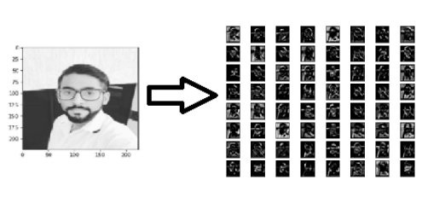
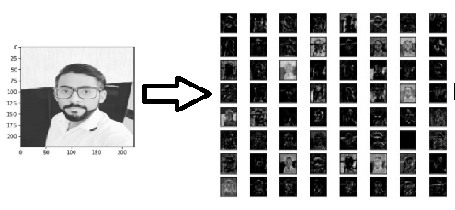
Region of interest(ROI) visualization
Approach A ROI visualization
Approach B ROI visualization

Slide 33
Conclusion
Transfer learning models provide better results than scratch models
Scratch models accuracy are low.
Transfer learning models are best suited for our task
Using transfer learning technique, model takes less time to train

Slide 34
References
[1] Octavio Arriaga, Matias Valdenegro-Toro, and Paul Pl¨oger. “Real-time convolutional neural networks for emotion and gender classification”. In: arXiv preprint arXiv:1710.07557 (2017).
[2] Farhad Goodarzi et al. “Real time facial expression recognition in the presence of rotation and partial occlusions”. In: Journal of Theoretical and Applied Information Technology 96 (Feb. 2018), pp. 854–864.
[3] Dan Duncan, Gautam Shine, and Chris English. “Facial emotion recognition in real time”. In: Stanford University (2016).
[4] Justus Schwan et al. “High-performance and lightweight real-time deep face emotion recognition”. In: 2017 12th International Workshop on Semantic and Social Media Adaptation and Personalization (SMAP). IEEE. 2017, pp. 76–79.
[5] Enrique Correa et al. “Emotion recognition using deep convolutional neural networks”. In:Tech. Report IN4015 (2016)
[6] Kaipeng Zhang et al. “Joint face detection and alignment using multitask cascaded convolutional networks”. In: IEEE Signal Processing Letters 23.10 (2016), pp. 1499–1503.
[7] Google images

Slide 35
Thank You

